Slide 1

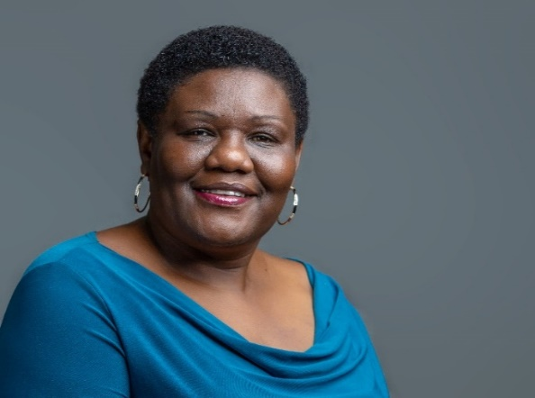

Module 3: Designing Equitable Partnerships
Day 2
Sarah Akello Esimu, PhD

Slide 2



Outline
Co-creation of shared vision, objectives and governance structures
01
Roles and responsibilities Matrix RACI (Responsible, accountable, consulted & Informed)
Negotiations, MoU, agreements, joint budgeting, ethics and power dynamics

Slide 3


Designing equitable partnerships
It requires shifting away from transactional, top-down models toward frameworks centered on shared power, mutual benefit and transparency.
.
True equity means recognizing that resource-rich partners do not hold a monopoly on expertise, and that local or community-level knowledge is equally valuable.

Slide 4


Co-Creation of Shared Vision, Objectives & governance structure
Building a shared vision ensures all parties share a common mental model of the partnership's future
Express ideas clearly, provide concise instructions, and ensure participants understand objectives and processes.
Once the vision is set, partners co-design practical milestones using agile frameworks to achieve objectives
Governance manages power asymmetries, handles resource distribution, and sustains the collaboration. HEIs establish collaborative governance through specific mechanisms .

Slide 5
Roles and responsibilities matrix RACI (Responsible, Accountable, Consulted & Informed)
It clarifies who does the work, who holds final authority, who provides expert advice, and who receives progress updates, thereby preventing operational friction across cross-institutional
1
Recognize and respond to emotional dynamics within the group, managing tensions and fostering a supportive environment
2
R: The "doer" who completes the specific task or operationalizes the partnership goal
A: The person with final sign-off authority and ultimate ownership of the outcome
C: Subject matter experts whose opinions are required before a decision is made
3
3
I: Stakeholders who only need to be kept up-to-date on project progress

Slide 6
RACI matrix
Partnership Tasks & Deliverables | Lead University | Partner University | Joint Steering Committee | Faculty/Project Leads | Administration
Drafting Partnership MOU & Legal Agreements | C | C | A | R | C
Curriculum or Joint Research Development | I | I | C | R | I
Securing Funding / Grant Management | A | C | I | R | R
Marketing and Student/Staff Recruitment | I | I | I | C | R
Student Admissions & Credit Transfer processing | I | I | I | C | R
Annual Progress Reports and Quality Audits | C | C | A | R | R

Slide 7
Negotiations, MoU, agreements, joint budgeting, ethics and power dynamics
Actions
Negotiations
MoU
Agreements
Joint budgeting
Ethics. ⚖️
Power dynamics
🤝
Setting Priorities, faculty Involvement and Admni. review
📝
Non-Binding Frameworks, Broad Scope, Umbrella Structure
✍️
Legally Binding, Resource Allocation and risk mgt
💰
Cost-Sharing Models, Currency & Inflation, grant compliance
Integrity, benefit sharing, cultural respect
Resource inbalance, Co-design Strategies, Mutual Capacity Building
⚡

Slide 8
Partnerships for teaching capacity among Higher Education Institutions (HEIs) are handled
through structured, multilateral frameworks designed to share pedagogical practices, expand faculty skills, modernize curricula.
Instead of working in isolation, universities pool their resources to improve how their educators teach
Module 4
Partnership
for
teaching capacity

Slide 9
Curriculum co- development
is a collaborative process where educators, students, industry professionals share decision-making to design learning outcomes, resources, assessments.
1
2
This partnership breaks traditional power dynamics to ensure the curriculum is relevant, engaging, and aligned with real-world skills
.
3
Core potential models: Educator & Student, Educator & Industry and; Institutional & Community

Slide 10
Work-based learning
1
WBL is a collaborative model where educators and employers partner to merge classroom instruction with real-world work experience
.
  This partnership is carried out through joint curriculum design, shared mentorship, structured and continuous engagement.
2
This is carried out thru Curriculum Co-Design and Alignment, Structured Program Delivery Models, Joint Mentorship ,Evaluation, shared responsibilities.
3

Slide 11
  Joint Program Delivery
1
Joint program delivery is a collaborative strategy where multiple org. pool resources, expertise, and funds to achieve shared objectives.
Specifically invite quiet individuals by name: "Sarah, I'd be interested in your perspective on this." Make it easy for them to decline gracefully if needed.
2
It is carried out through a structured lifecycle e.g. strategic alignment, joint planning, formal agreements, shared execution and mutual accountability
3
e.g. Strategic Alignment & Planning, Formalization, Execution & Governance,
Monitoring, Accountability & Evaluation

Slide 12
Faculty Exchange
1
  Faculty exchange and development under institutional partnerships are carried out through structured formal agreements that pool resources to enhance teaching, research and institutional capacity.
Visiting Professorships: Faculty teach semester-long courses abroad.
Co-Teaching Models: Professors co-deliver virtual or hybrid classes.
.
2
Capture off-topic points for later: "Let's note that idea here and come back to it if time allows. For now, let's stay focused on..."
Research Sabbaticals: Scholars access partner laboratories and archives.
3
Shadowing Programs: Admin. observe partner institutional governance
.

Slide 13
Teaching infrastructure
TI sharing under a partnership is carried out through structured long-term contracts that pool resources between governments, private entities, and educational institutions to build, maintain optimize educational facilities. .
1
2
  This mechanism leverages private sector efficiency and public sector oversight to maximize asset utilization and lower operational costs.
.
3
Design-Build-Finance-Maintain (DBFM) e.g. class rooms, Build-Operate-Transfer (BOT) and Educational Management Organizations (EMOs)

Slide 14
Thank you for listening

